Slide 1
Automated UI Tests
May 2016

Slide 2
Agenda
Strategy
What
CI process demo
How
Test framework
cucumber, appium, watir
page-object approach
Test scenarios
Maintenance

Slide 3





Apps

Slide 4
Apps
iOS | iOS | iOS | iOS
Android | Android | Android | Android
Windows |  |  | Windows | Windows
Web |  |  |  | Web

Slide 5
Automated UI Test
iOS | iOS | iOS | iOS
Android | Android | Android | Android
Windows |  |  | Windows | Windows
Web |  |  |  | Web

Slide 6
Automated UI Test
iOS | iOS | iOS | iOS
Android | Android | Android | Android
Windows |  |  | Windows | Windows
Web |  |  |  | Web

Slide 7
Automation
Improve efficiency and effectiveness of testing
CI is foundation
Catch regression in key workflows
Consistent automation strategy across apps and platforms
Apps being rebuilt on common framework/underlying SDKS == great for automation

Slide 8
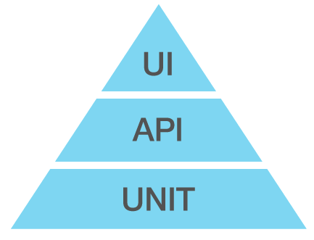
Priorities
We cannot and should not automate everything
Prioritize
Key workflows
Things difficult to test manually
Things prone to instability
Things we are highly dependent on

Slide 9
demo
http://ekotest.esri.com:8080
Notes:
we have automated UI tests for iOS apps and workforce web app running on ekotest jenkins server
this server managing serveral test machine
apptest, droidtest, mac
a linux machine, a windows7 machine
the way how it works is
for ios app, when the appframework repo, or app repo got a merge, that trigger a build, once build succeed, it kicks off its coorsponding test, an usual case is that when there is a merge on appframework repo, 3 apps got rebuild... then tests run parallelly on 3 mac machines
for web app, it monitor, the staging deplyment, once found a new deployment, it start tests on several machine with different browser, chrome, firefox, IE
once the test is done, it send a link to the report to slack channel
that is for develop branch, it also allows to run test against a branch build and a specifiy url for web app
the test report is like this, if fail, it has error msg, call stack, screenshot to help you identify the reason of the failure.

Slide 10


CI process for iOS-sf app automated test
appframework-sf
workforce-sf
build latest develop branch or selected branches
run appium tests against the develop build or branch build
#automated-test
#appium

Slide 11
CI process for workforce-js automated test
workforce-js
UI test of latest develop branch deployment
UI test against a given deployment url
#automated-test
#appium
http://workforce.stage.arcgis.com
http://workforce.stage.arcgis.com/?index_key=809866
http://workforce.arcgis.com

Slide 12
Test Framework
Evaluation
appium, calabash, eggplant, robotium, tenkod, espresso ...
selenium ...
Test framework
cucumber, appium, watir
page-object approach
coded in ruby
web driver protocol
cucumber
appium ruby client lib
Watir
appium server
web app in browser (web driver server)
iOS apps

Slide 13
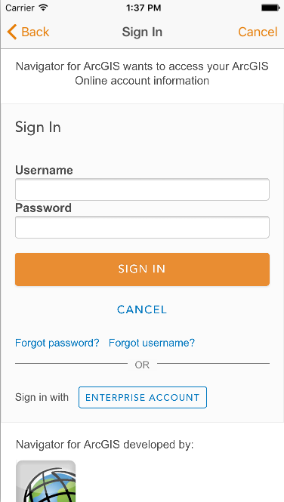
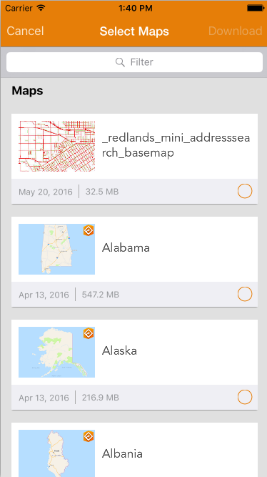
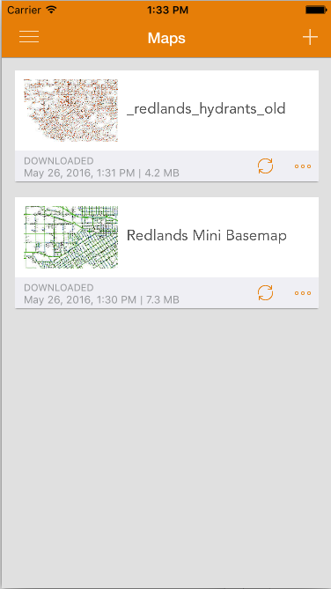
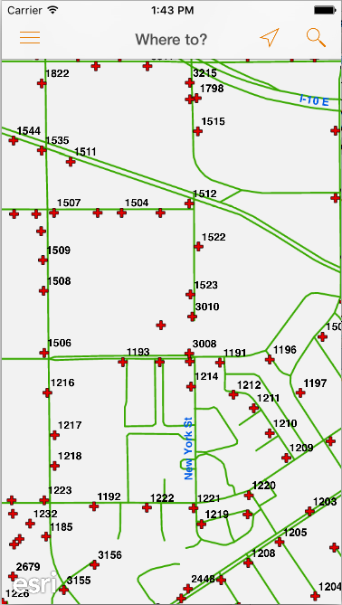
Test Framework - iOS
cucumber
Feature
Feature: Manage Maps
Scenario: download then remove mmpk
Given I sign in as "ar_NavUITest" / "navuitest1"
Then I search and download a map titled "redlands_mini_basemap"
Then I open map ”redlands_mini_basemap "
Then I open browse maps screen
Then I check map details info of ”redlands_mini_basemap "
Then I remove a map titled ”redlands_mini_basemap "
Then I sign out
Secnario
step
appium ruby client lib
appium server
iOS app

Slide 14
Test Framework - iOS
cucumber
Feature
Feature: Manage Maps
Scenario: download then remove mmpk
Given I sign in as "ar_NavUITest" / "navuitest1"
Then I search and download a map titled "redlands_mini_basemap"
Then I open map ”redlands_mini_basemap "
Then I open browse maps screen
Then I check map details info of ”redlands_mini_basemap "
Then I remove a map titled ”redlands_mini_basemap "
Then I sign out
Secnario
step
appium ruby client lib
And(/^I open map "([^"]*)"$/) do |map_name|
_browse_maps_screen = $mobile_app.wait_for_screen(BrowseMapsScreen)
_browse_maps_screen.open_map(map_name)
end
appium server
class BrowseMapsScreen < ScreenBase
...
def open_map(map_name)
...
maps = find_elements(:xpath, "//UIACollectionCell/UIAStaticText[contains(@name,'#{map_name}')]")
...
maps.first.click
end
end
iOS app

Slide 15
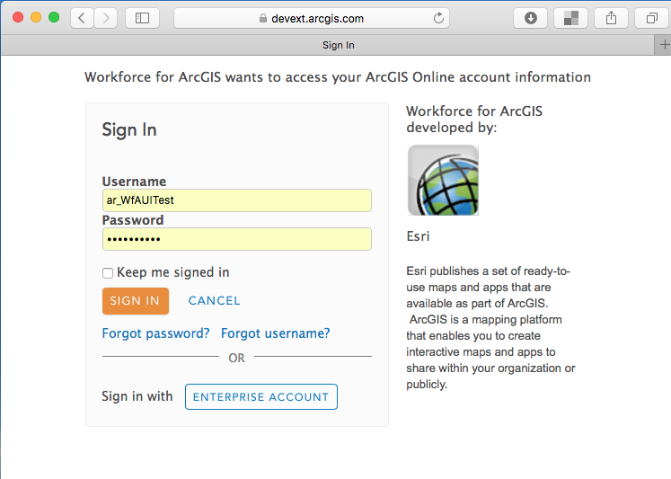
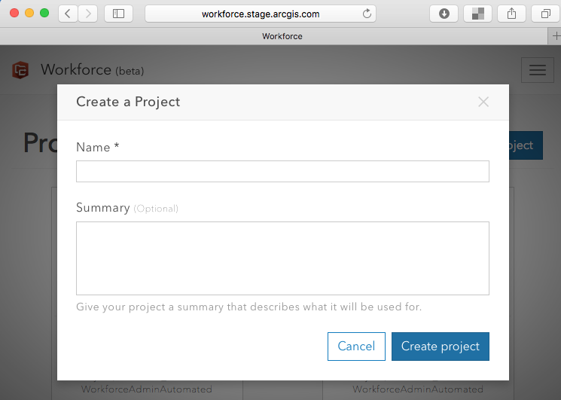
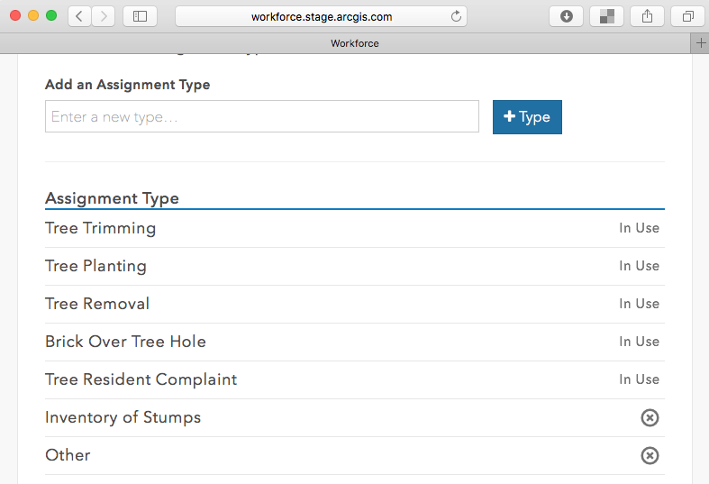
Test Framework – web app
cucumber
Feature
Feature: test project prep: prepare a new project ready for other test features
Scenario: prepare a test project
Given I launch the web app
Then I sign in as "ar_WfAUITest" / "wfauitest1"
Then I create a project with name: "Automated-Test-JS" and description: "new project"
Then I add assignment type "Tree Trimming”
...
Then I add assignment type "Other"
Then I add user "ar_WfUITest WorkforceAutomated" as a "Mobile Worker"
Secnario
step
watir
web app in browser (webdriver server)

Slide 16
Test Framework – web app
cucumber
Feature
Feature: test project prep: prepare a new project ready for other test features
Scenario: prepare a test project
Given I launch the web app
Then I sign in as "ar_WfAUITest" / "wfauitest1"
Then I create a project with name: "Automated-Test-JS" and description: "new project"
Then I add assignment type "Tree Trimming”
...
Then I add assignment type "Other"
Then I add user "ar_WfUITest WorkforceAutomated" as a "Mobile Worker"
Secnario
step
Then(/^I sign in as "([^"]*)" \/ "([^"]*)"$/) do |username, password|
_welcome_screen = $web_app.wait_for_screen(WelcomeScreen)
_oauth_screen = _welcome_screen.sign_in_screen
_project_list_screen = _oauth_screen.sign_in(username, password)
end
watir
class AgolOauthScreen < ScreenBase
...
def sign_in(username, password)
$browser.text_fields[1].set username
$browser.text_fields[2].set password
$browser.buttons[1].click
...
end
...
end
web app in browser (webdriver server)

Slide 17
test scenarios
workforce-test-catalog
workforce-sf issues
Issue# *
Issue#1
Description
Data/Cred
Steps/expected
Issue#3
Description
Data/Cred
Steps/expected
Issue#1
error message after opening an invalid project
Issue#3
Issue# *
Issue#2
Description
Data/Cred
Steps/expected
Issue#4
Description
Data/Cred
Steps/expected
Issue#2
Issue#4
Test scenario: projects
Map/account
Steps
Test scenario:
assignments
Map/Account
Steps
. . .
Test scenario:
Worker
Map/Account
Steps
workforce-sf test scenarioes

Slide 18
Maintenance
workforce-sf-appium-test
appframework-sf
workforce-sf
test run on jenkins server
failed?
regression in app?
test data, server?
app changed?
stabilize the test code
#automated-test
#appium

Slide 19
Maintenance
reasons for failures
UI change
http://ekotest.esri.com:8080/view/Test_JS/job/Workforce-JS-Test-Develop-IE11/199/cucumber-html-reports/
Regression
http://ekotest.esri.com:8080/job/NavigatorSF-Develop-Appium-Test/49/cucumber-html-reports/Settings.feature.html (start navigator bar missing)
http://ekotest.esri.com:8080/job/Workforce-JS-Test-Develop-Chrome/351/cucumber-html-reports/CreateAssignment.feature.html (not be able to create assignment)

Slide 20
links
Test server: http://ekotest.esri.com:8080
Test repo
https://devtopia.esri.com/jian5589/workforce-sf-appium-test
https://devtopia.esri.com/jian5589/navigator-sf-appium-test
https://devtopia.esri.com/heat4175/explorer-sf-appium-test
https://devtopia.esri.com/jian5589/collector-sf-appium-test
https://devtopia.esri.com/jian5589/workforce-js-test
https://devtopia.esri.com/jian5589/navigator-af-appium-test
https://devtopia.esri.com/lian6084/workforce-af-appium-test
Test catalog
https://devtopia.esri.com/apps/workforce-test-catalog
https://devtopia.esri.com/apps/navigator-test-catalog
Notes about test framework
https://devtopia.esri.com/apps/qa-common/wiki/Automation
https://devtopia.esri.com/heat4175/explorer-sf-appium-test/wiki/appium-cucumber-test-framework
https://devtopia.esri.com/jian5589/workforce-js-test/wiki/Watir-Cucumber-test-framework

